Slide 1

KINGDOM OF SAUDI ARABIA
Ministry of Education
King Khalid University
College of Computer Science
المملكة العربية السعودية
وزارة التعليم
جامعة الملك خالد
كلية علوم الحاسب الآلي
Virtual Art Gallery
Abdulaziz Mousa Asiri | 442803093
Abdullah Ali Alhakami | 442811660
Abdulaziz Aboud Alkamil | 442802893
Naif Mohammed Asiri | 442803088
Supervised by: Dr. Mohammed Ashiq Rasool

Slide 2
Contents
Project Aim & Objectives
System Analysis
Interface Implementation
Software and hardware Requirement
Functional requirements
Database Design
User Interface
Testing
Conclusion
Future Work
References
Poster

Slide 3
Project Aim & Objectives
The aim of the Virtual Art Gallery project is to create an online platform that revolutionizes the art industry by providing emerging artists with a dedicated space to showcase, promote, and sell their artwork. The objectives of the project include:
Designing an immersive online platform that offers a virtual art display for artists to showcase their artwork.
Implementing a secure and user-friendly e-commerce system that allows artists and art enthusiasts to buy and sell artwork.
Creating artist profiles that provide insights into their work, allowing users to connect with the artists.
Organizing curated virtual exhibitions to enhance the online art viewing experience and promote artists' work.

Slide 4
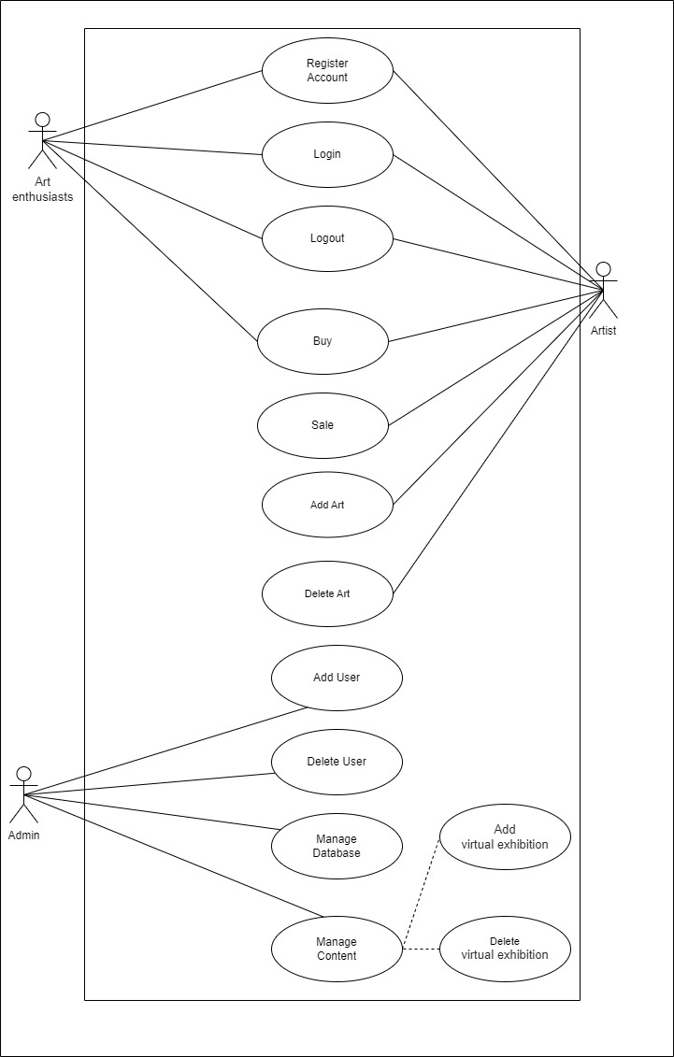
System Analysis
Use case diagrams

Slide 5
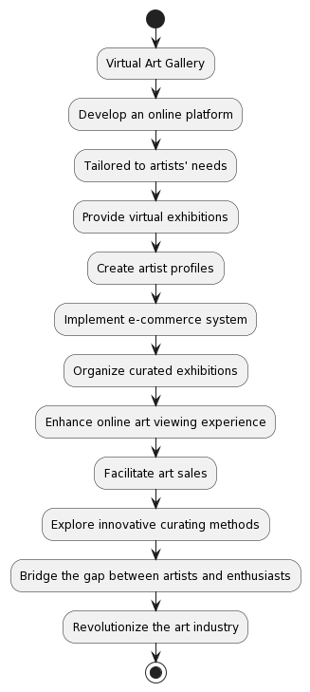
System Analysis
Process flow:

Slide 6
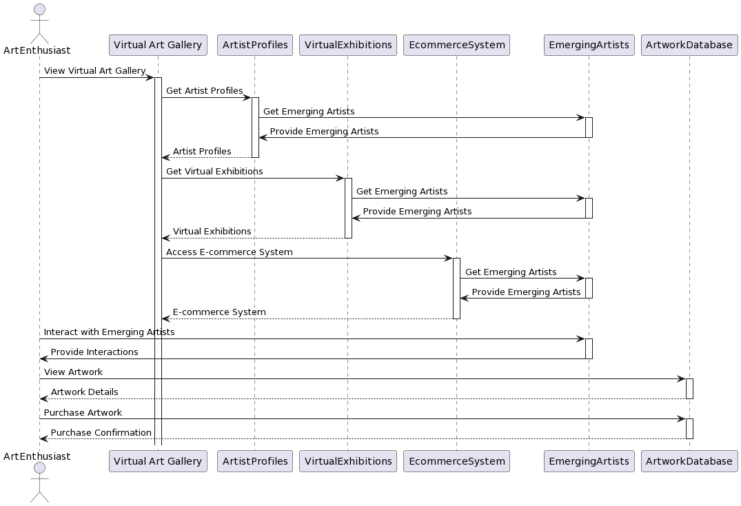
System Analysis
Sequence Diagram:

Slide 7
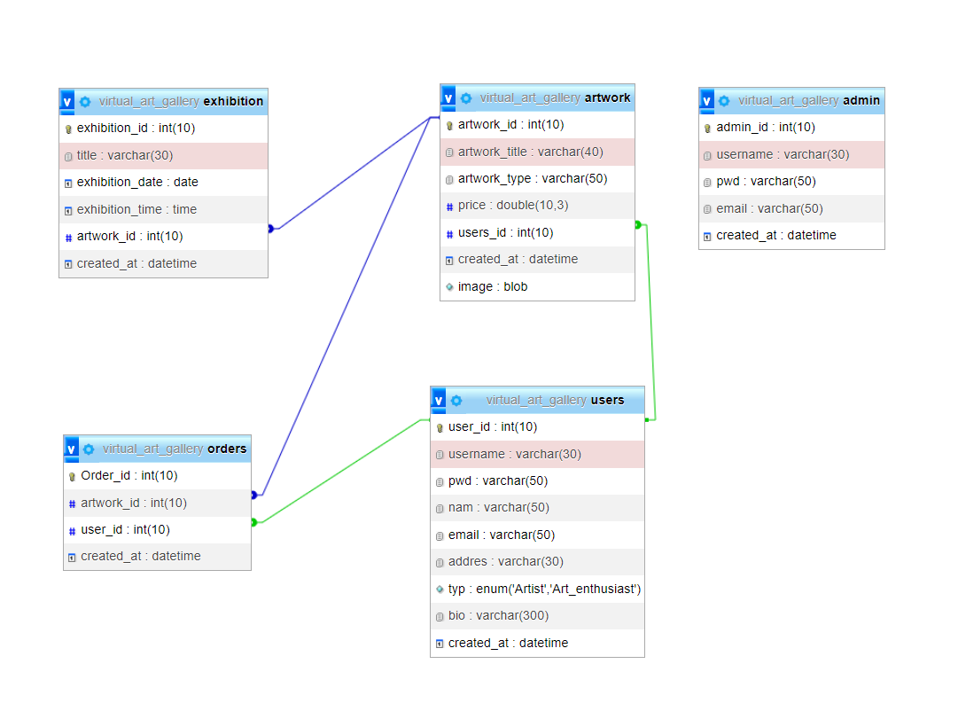
System Analysis
Database Diagram:

Slide 8
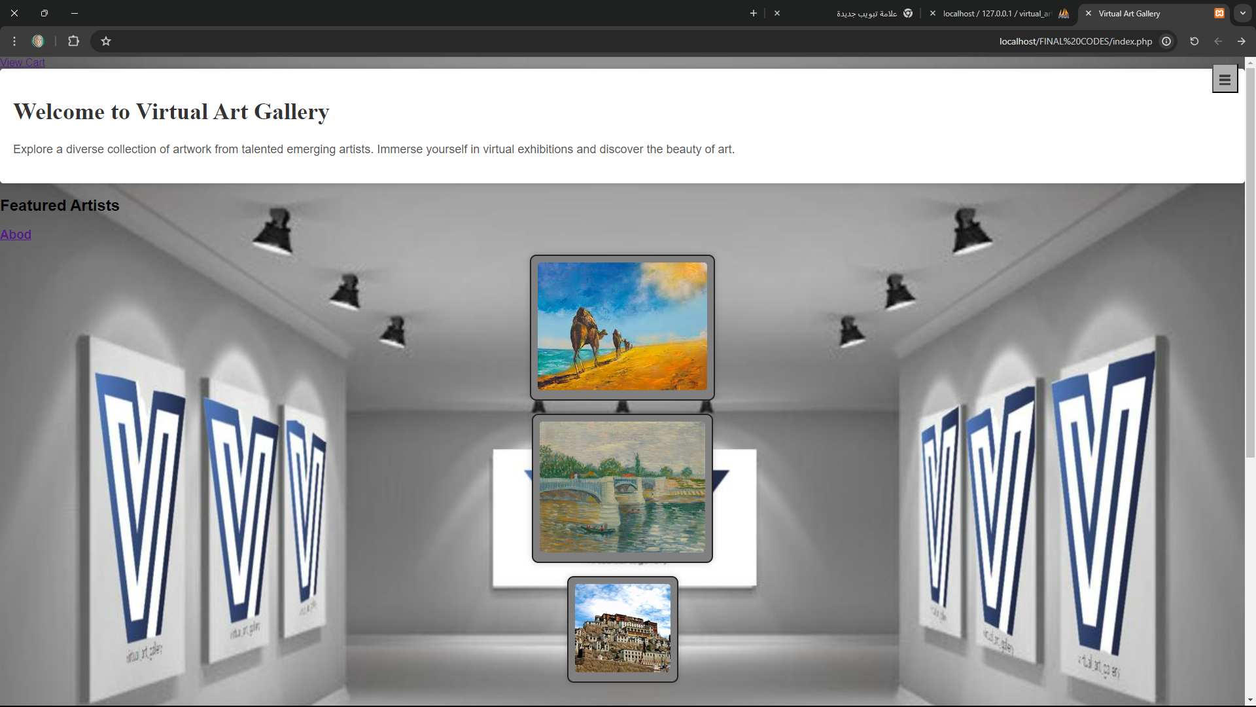
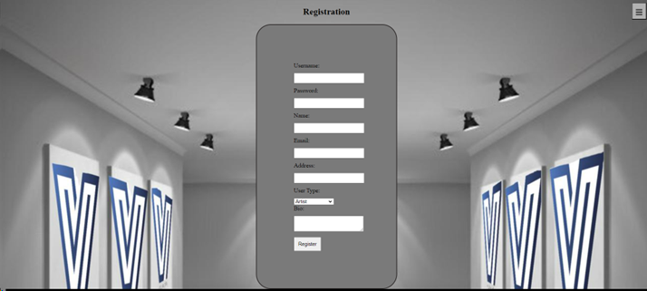
Interface Implementation
<!DOCTYPE html>
<html>
<head>
<title>Virtual Art Gallery</title>
<!-- Add your CSS styling and other dependencies here -->
</head>
<body>
<header>
<!-- Include the header.php file to display the website header -->
<?php include 'header.php'; ?>
</header>
<main>
<?php
if ($_SERVER["REQUEST_METHOD"] == "POST") {
$username = $_POST["username"];
$pwd = $_POST["pwd"];
$nam = $_POST["nam"];
$email = $_POST["email"];
$addres = $_POST["addres"];
$typ = $_POST["typ"];
$bio = $_POST["bio"];
try {
require_once "dbh.inc.php";
$query = "INSERT INTO users (username, pwd, nam, email, addres, typ, bio) VALUES (:username, :pwd, :nam, :email,

Slide 9
Software and hardware Requirement
Hardware:
Enough disk space and RAM for web browser
Router and internet connection
pc with good processor like intel I5 and may be 8GB RAM
Software:
PHP system, html, CSS, JavaScript, Mysql and visual studio, three.js Modules.
For the server XAMP.

Slide 10
Functional requirements
User Registration and Profiles
Virtual Art Display
E-commerce Functionality
Virtual Exhibitions Event
Responsive Design and Compatibility
Admin Panel

Slide 11
Database Design
The database design for the Virtual Art Gallery project plays a crucial role in storing and managing the artwork, artist profiles, user information, and transaction details. It includes the following components:
Artwork Table: Stores information about each artwork, such as title, artist, description, price, and image.
Artist Table: Contains details about the artists, including their name, bio, contact information, and portfolio.
User Table: Stores user information, such as username, password, email, and shipping address.
Order Table: Records details of each transaction, including the buyer, seller, artwork, date, and payment information.

Slide 12
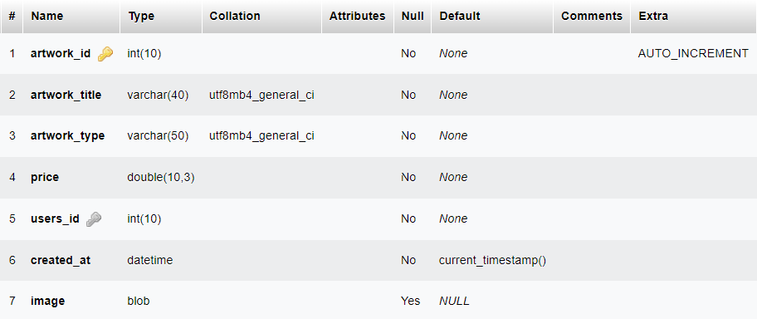
Database Design
Artwork table:

Slide 13
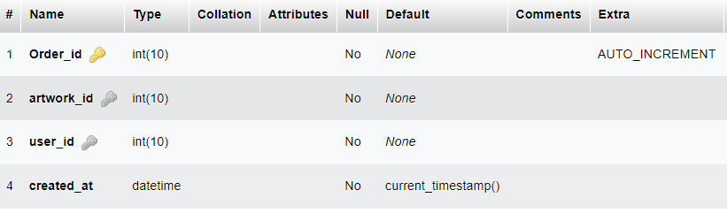
Database Design
Orders table:

Slide 14
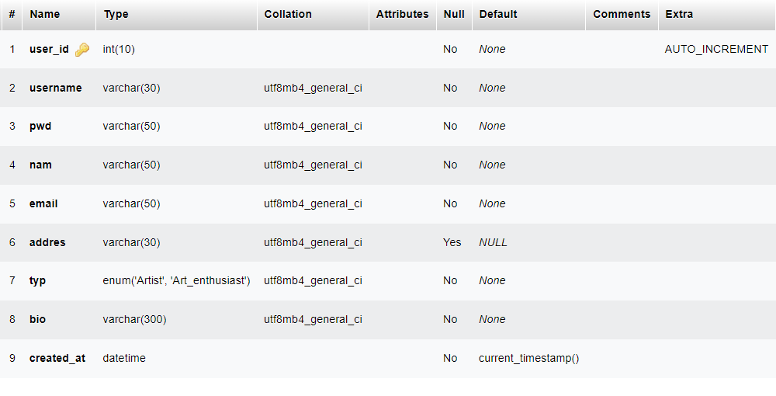
Database Design
Users table:

Slide 15
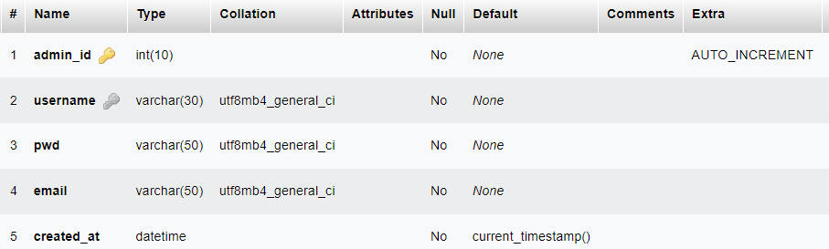
Database Design
Admin table:

Slide 16
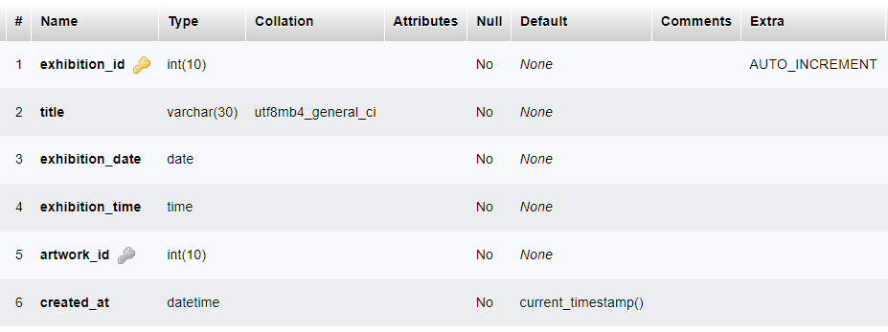
Database Design
Virtual exhibition table:

Slide 17
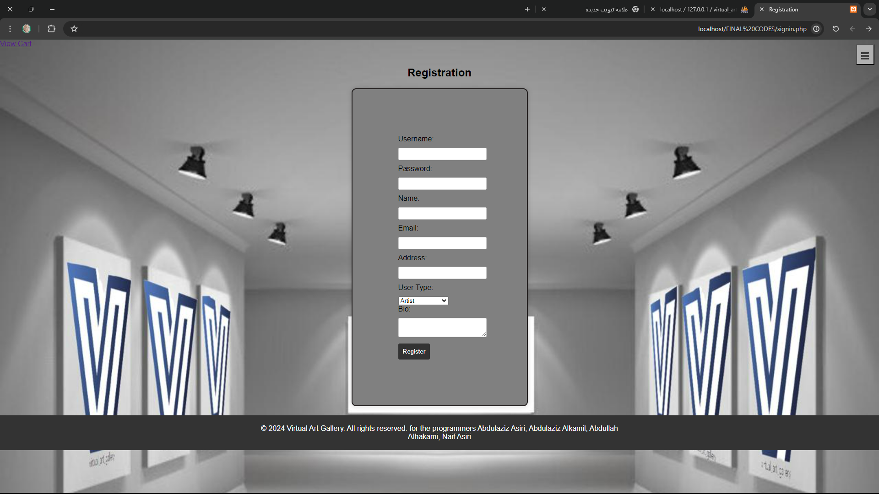
User Interface
Register page:

Slide 18
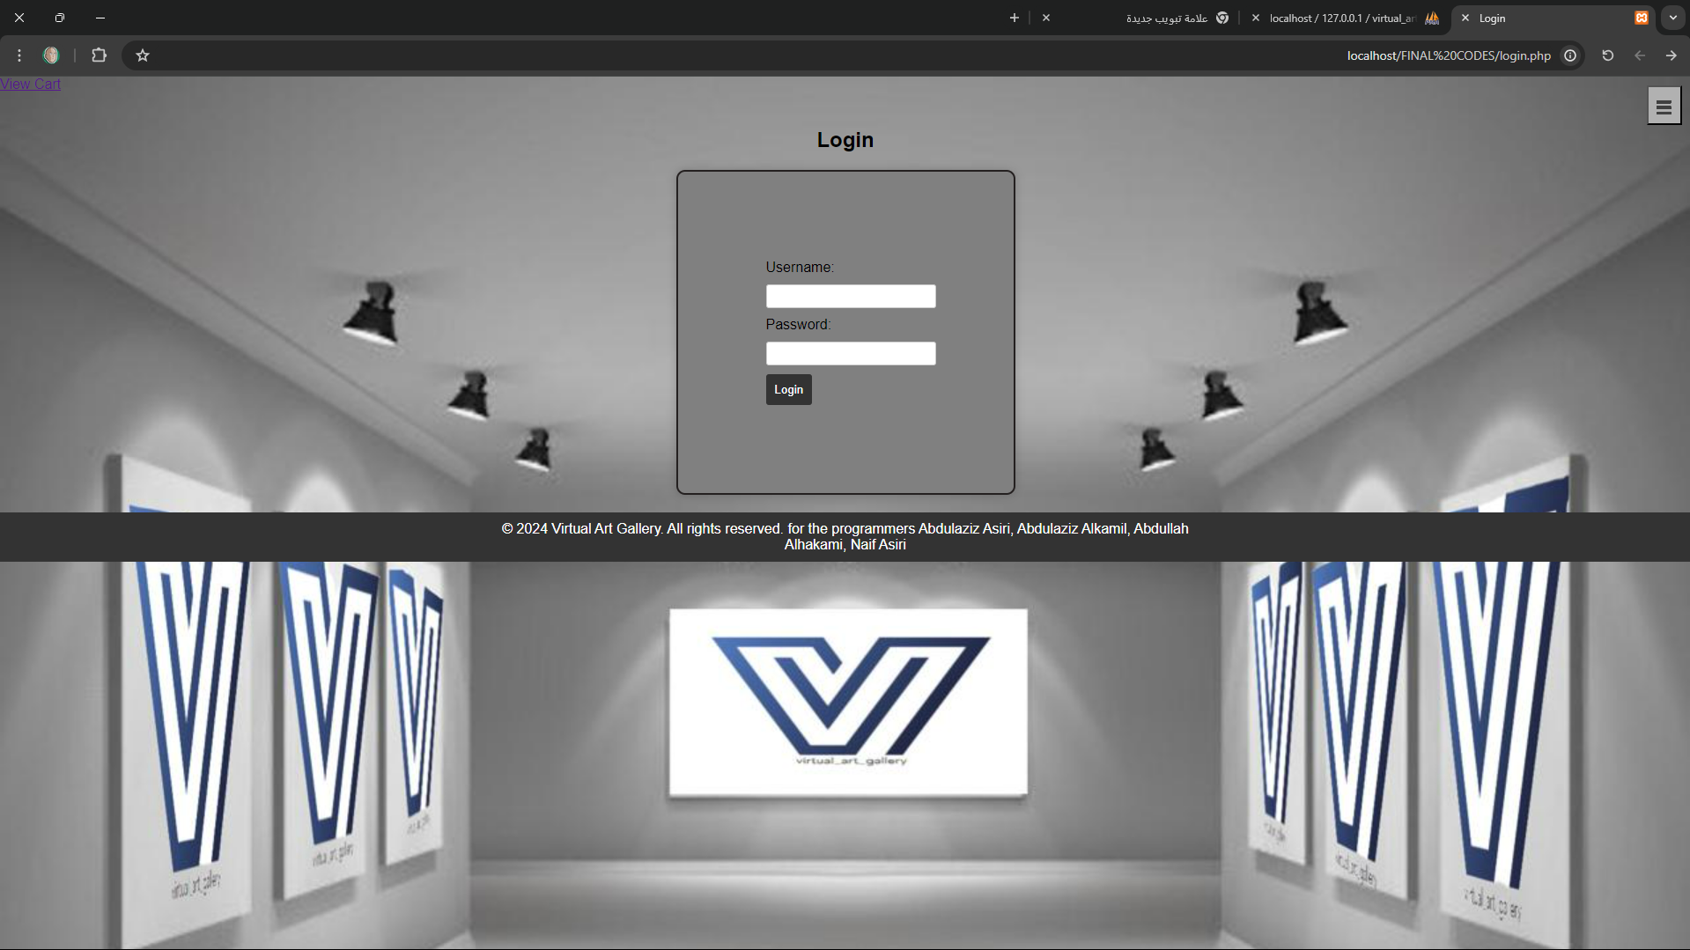
User Interface
Login page:

Slide 19
User Interface
home page:

Slide 20
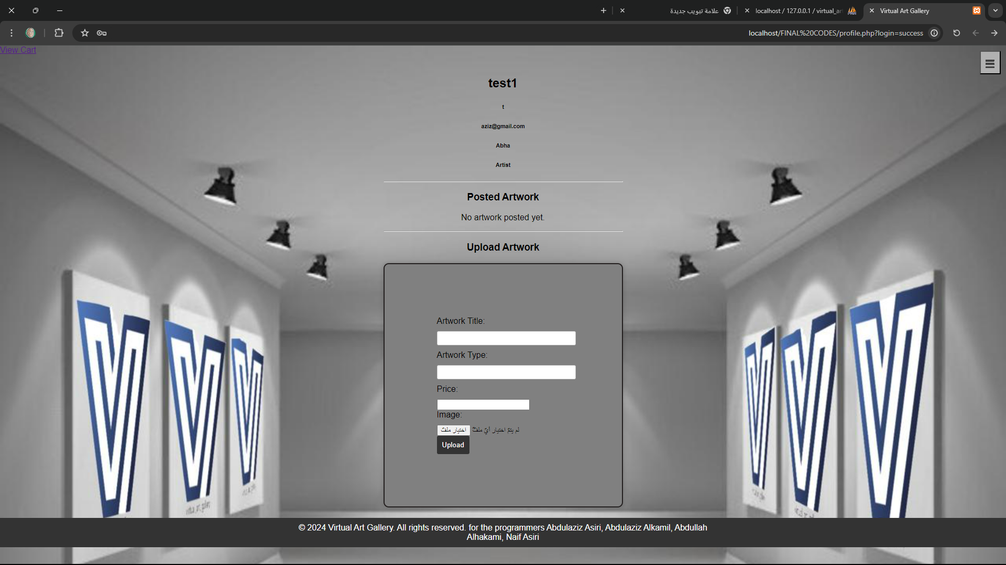
User Interface
User profile:

Slide 21
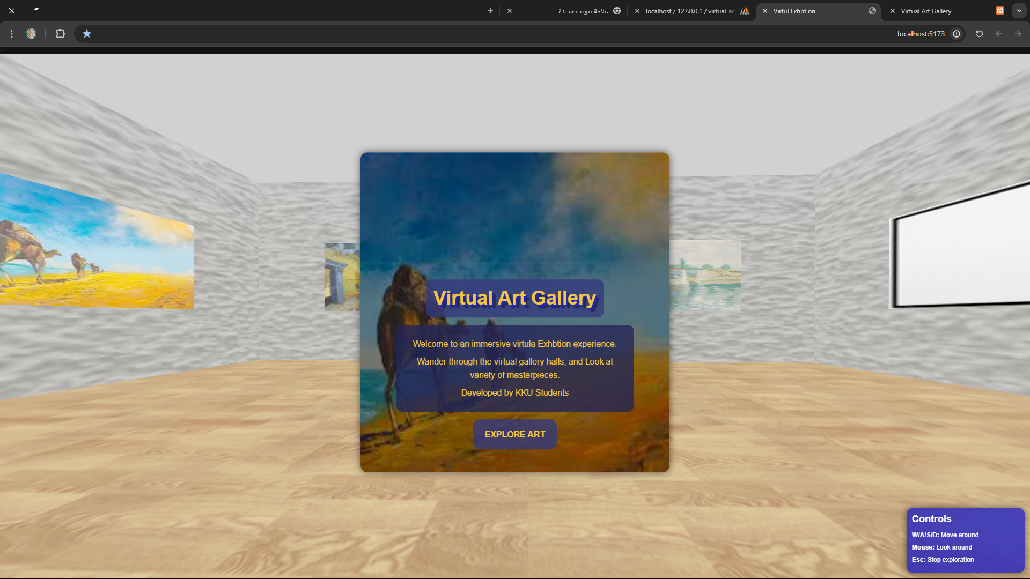
User Interface
Virtual Art Gallery :

Slide 22
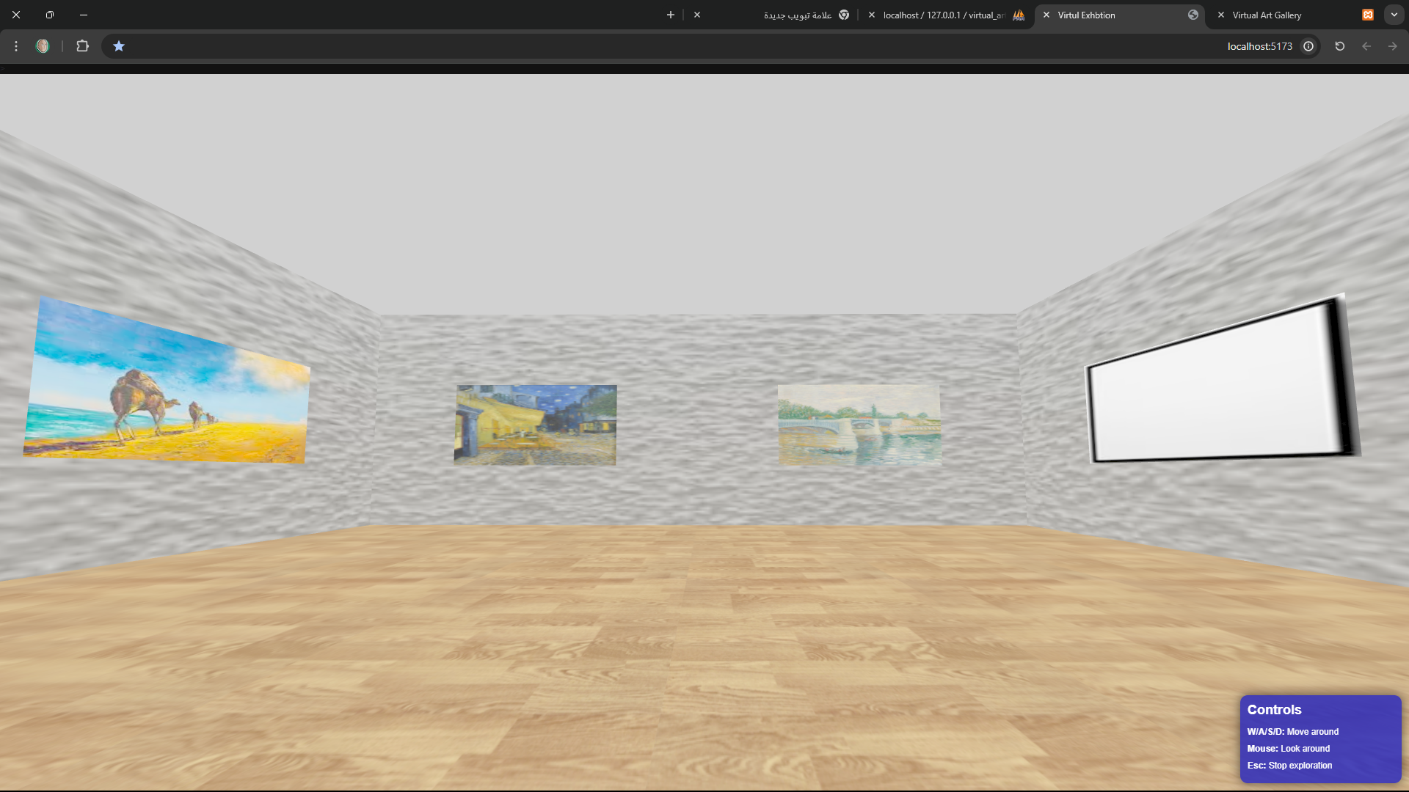
User Interface
Virtual Art Gallery :

Slide 23
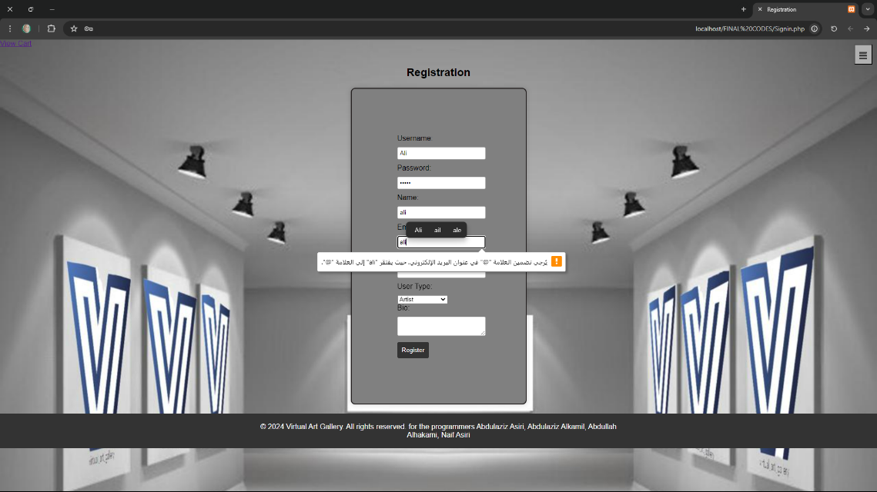
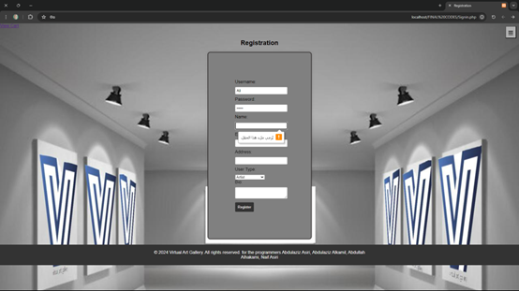
Testing
Register page:

Slide 24
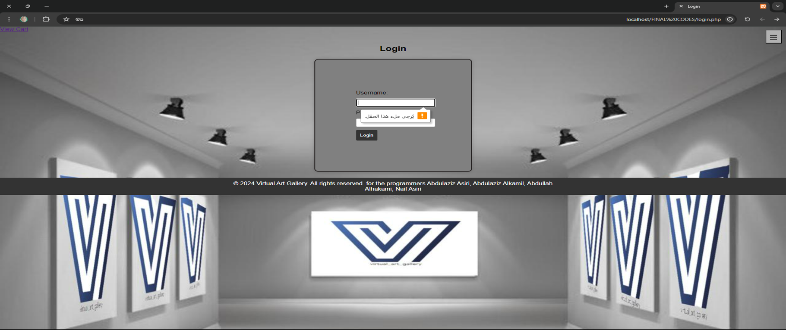
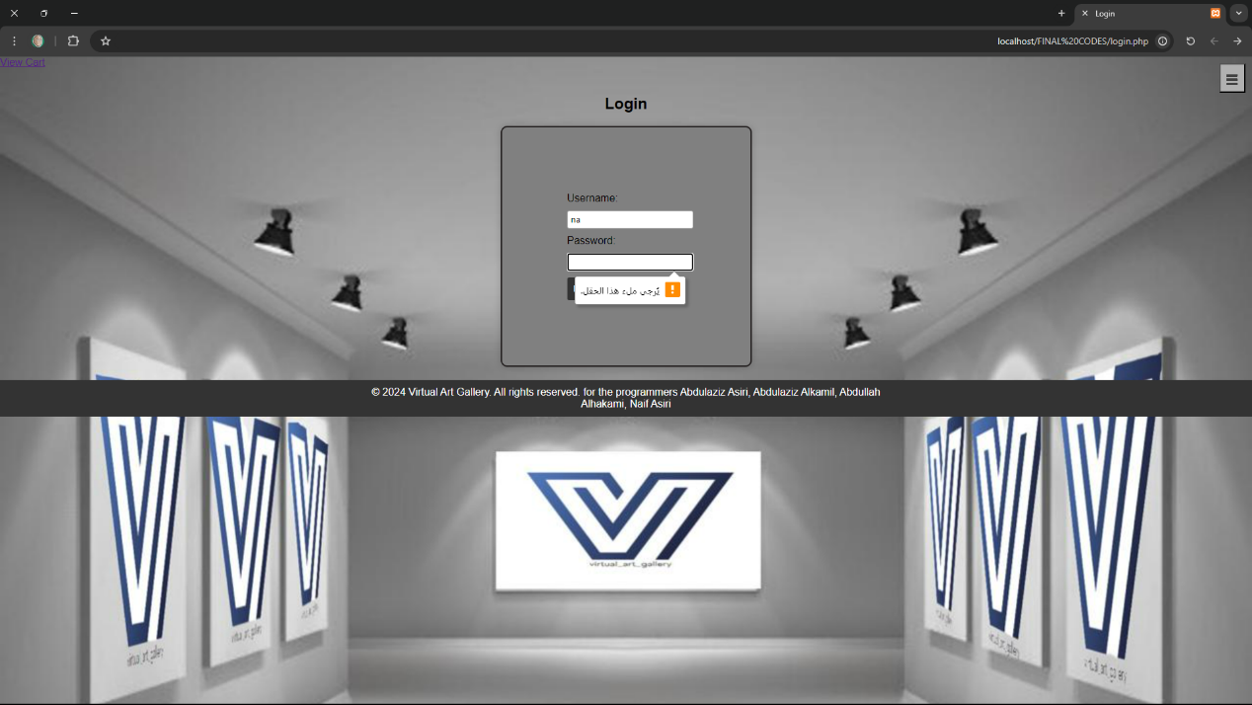
Testing
Login page:

Slide 25
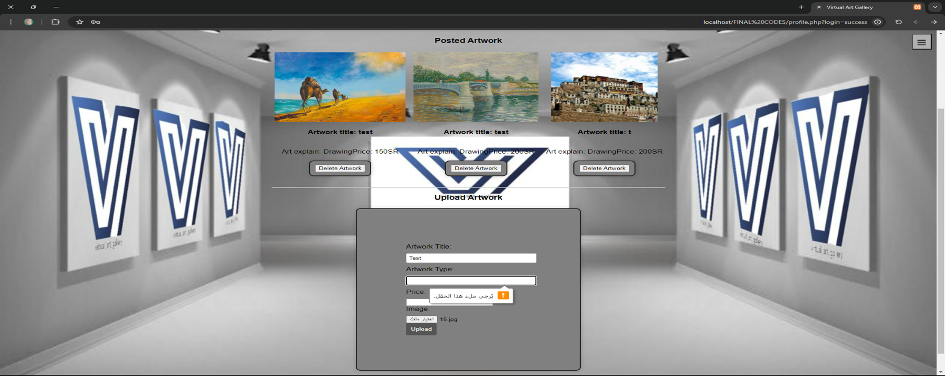
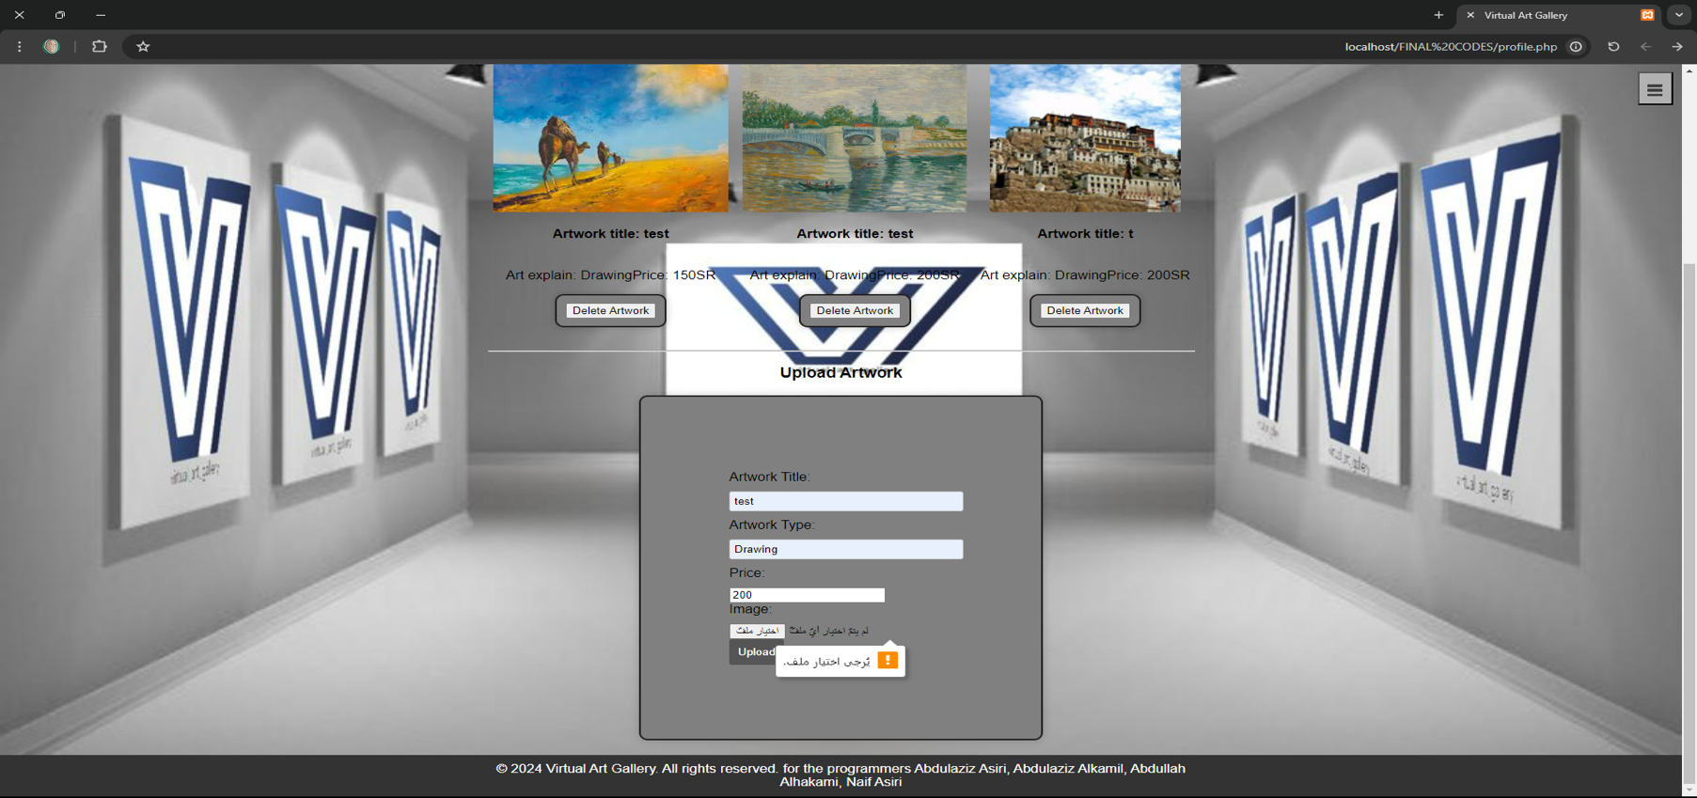
Testing
User profile:

Slide 26
Conclusion
In conclusion we completed most of the project and we are aiming to give the best possible outcome that satisfies everyone

Slide 27
Future Work
We should include any remaining futures and enhance the website to reach its final form at the end of this year.

Slide 28
References
[1]I. U. School of Informatics and Computing, "Thesis Formatting and Style," [Online]. Available: https://soic.iupui.edu/files/Thesis_Formatting_and_Style_Document.pdf. [Accessed 15 June 2015].
[2]U. o. B. C. Graduate and Postdoctoral Studies, "DISSERTATION & THESIS PREPARATION," [Online]. Available: https://www.grad.ubc.ca/sites/default/files/materials/thesis_review.pdf. [Accessed 21 June 2015].
[3]M. U. Department of Information System, "Final Year Project Handbook," 2012. [Online]. Available: http://www.cs.nuim.ie/sites/default/files/FYProjectHandbook- 2012-2013-final.pdf. [Accessed 5 July 2015].
[4] For virtual exhibition : https://www.artsteps.com/
[5]For drawing DFD at https://www.geeksforgeeks.org/levels-in-data-flow-diagrams-dfd/ & https://www.freeprojectz.com/dfd/online-art-gallery-dataflow-diagram

Slide 29
